Slide 1
Hot Jupiter
2022311224 이진진

Slide 2
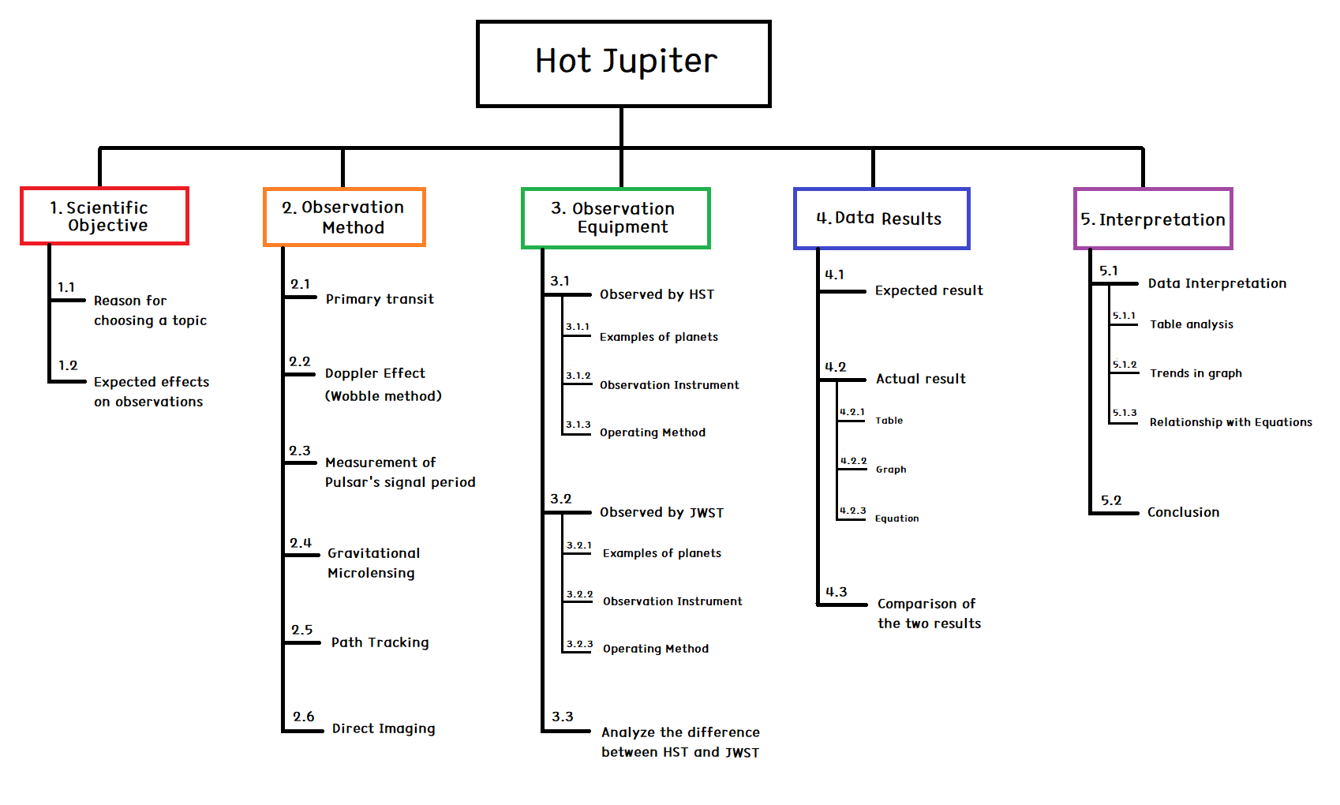
WBS

Slide 3
PLAN
Week 7 : Total WBS introduction / Scientific Objective 1.1, 1.2
Week 8 : Modifying overall WBS and PLAN / Observation Method 2.1, 2.2, 2.3
Week 9 : Observation Method 2.4, 2.5, 2.6
Week 10 : Observation Equipment 3.1
Week 11 : Observation Equipment 3.2, 3.3
Week 12 : Data Result 4.1
Week 13 : Data Result 4.2, 4.3
Week 14 : Interpretation 5.1, 5.2
Week 15 : (Blank Period)
Week 16 : Conference

Slide 4
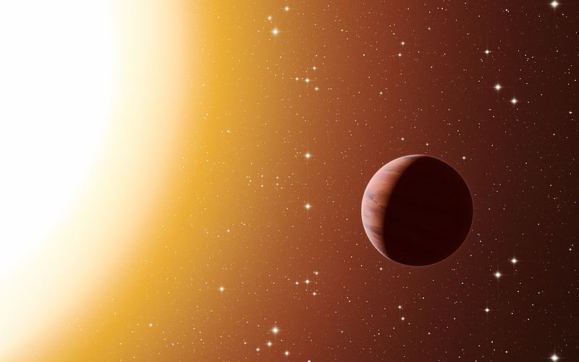
1.1
Reason for choosing a topic

Slide 5
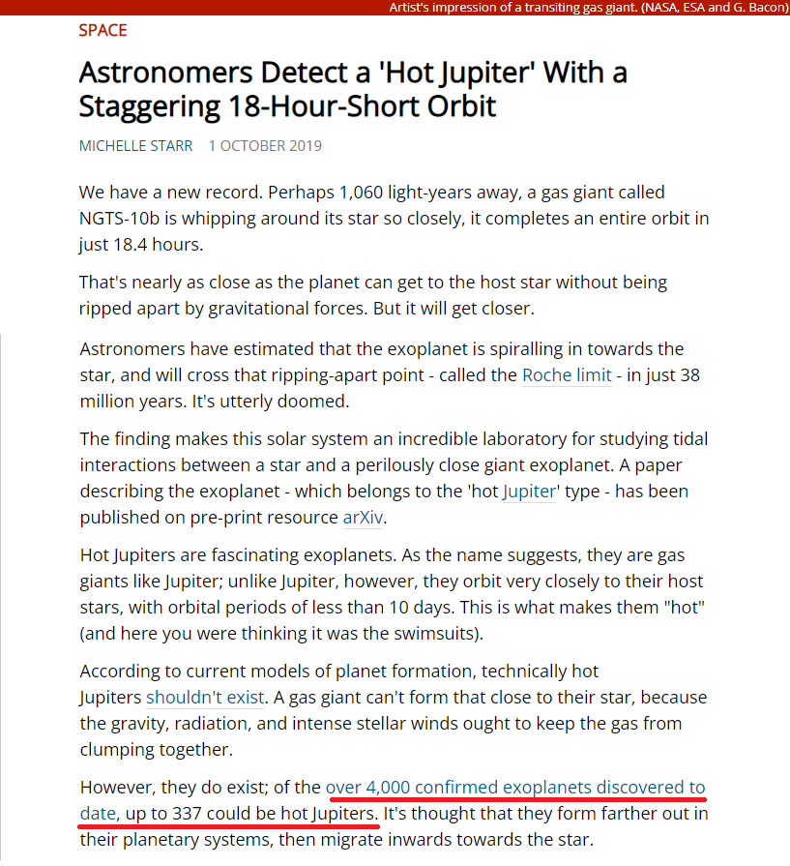
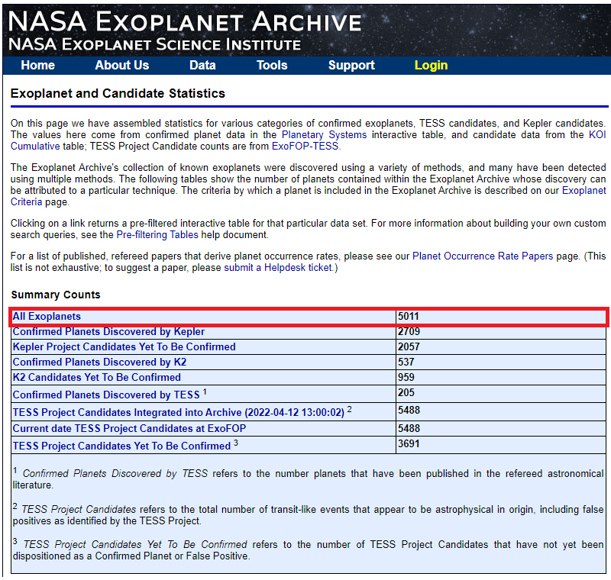
1.2
Expect effects on observation
https://exoplanetarchive.ipac.caltech.edu/index.html
https://www.sciencealert.com/extreme-hot-jupiter-orbits-its-star-at-an-absolutely-breakneck-18-hours

Slide 6
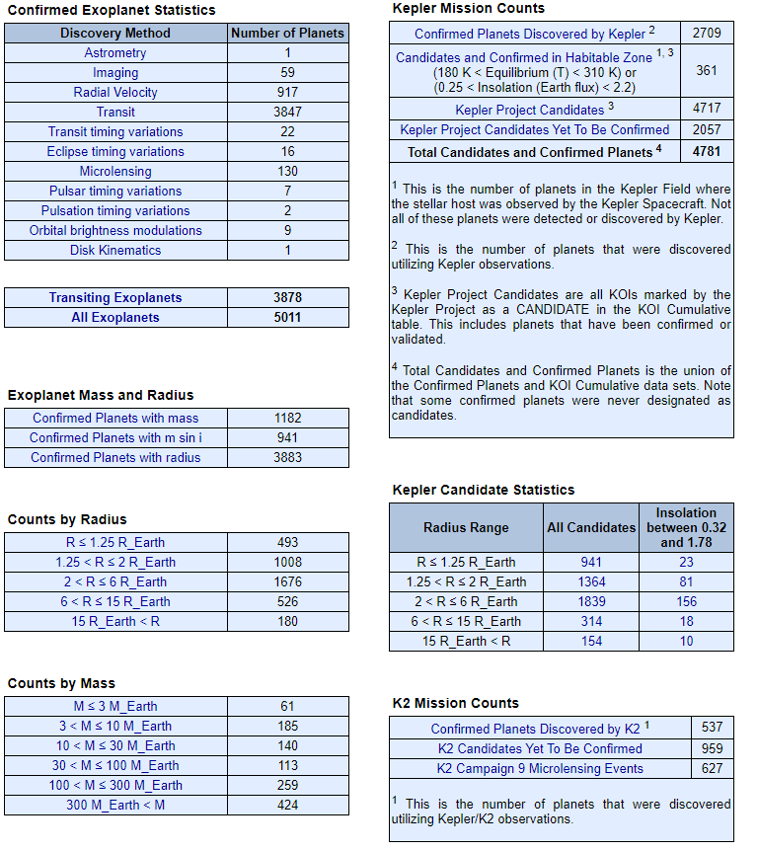
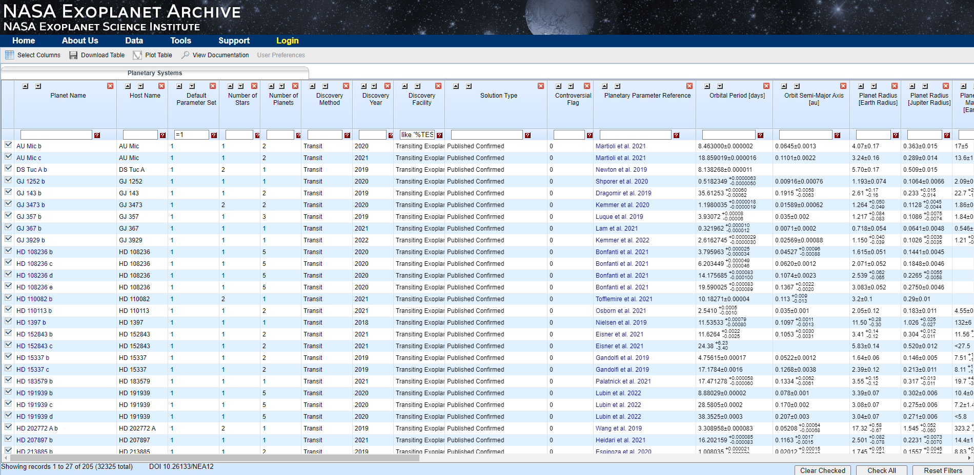

Slide 7
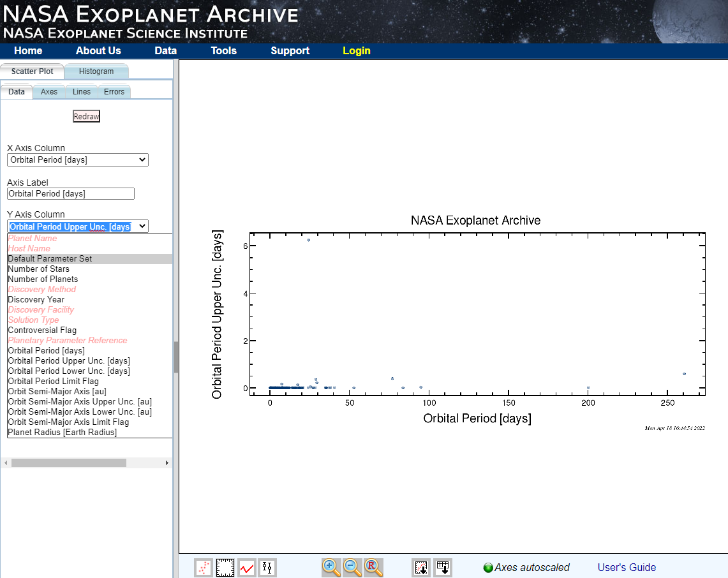

Slide 8
THANK YOU
FOR LISTENING

